Slide 1
Submitted by: Swathi Vimala
Course: Data Analyst / SQL
Year: 2026

Slide 2
Ticket Management System
“In this project, I built a Ticket Management System to handle customer complaints, assign agents, and track ticket status using SQL.

Slide 3
Why Ticket Management System?
“Companies receive many customer issues daily. Managing those manually is difficult. So we created a database system to store customer details, issues, agents, and ticket status.”

Slide 4
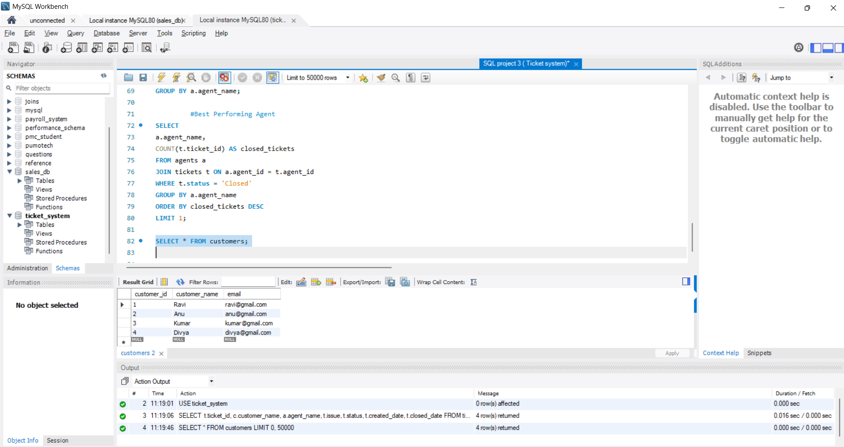
Customers
“Customer table stores name and email.

Slide 5
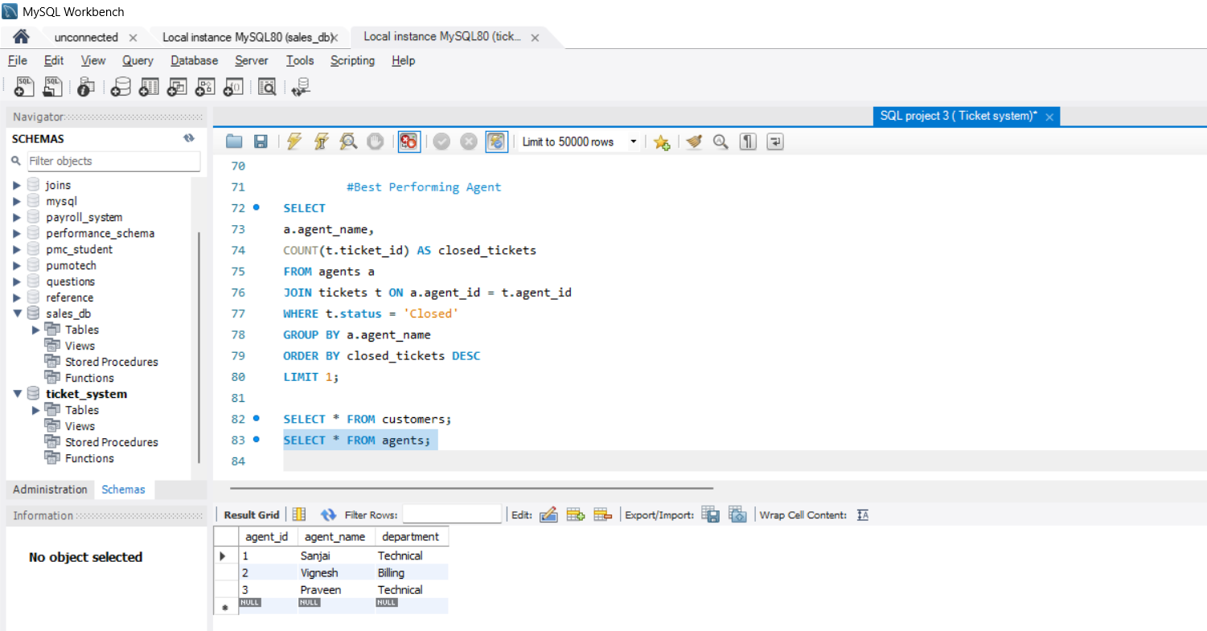
Agents
Agent table stores agent name and department like Technical or Billing.”

Slide 6
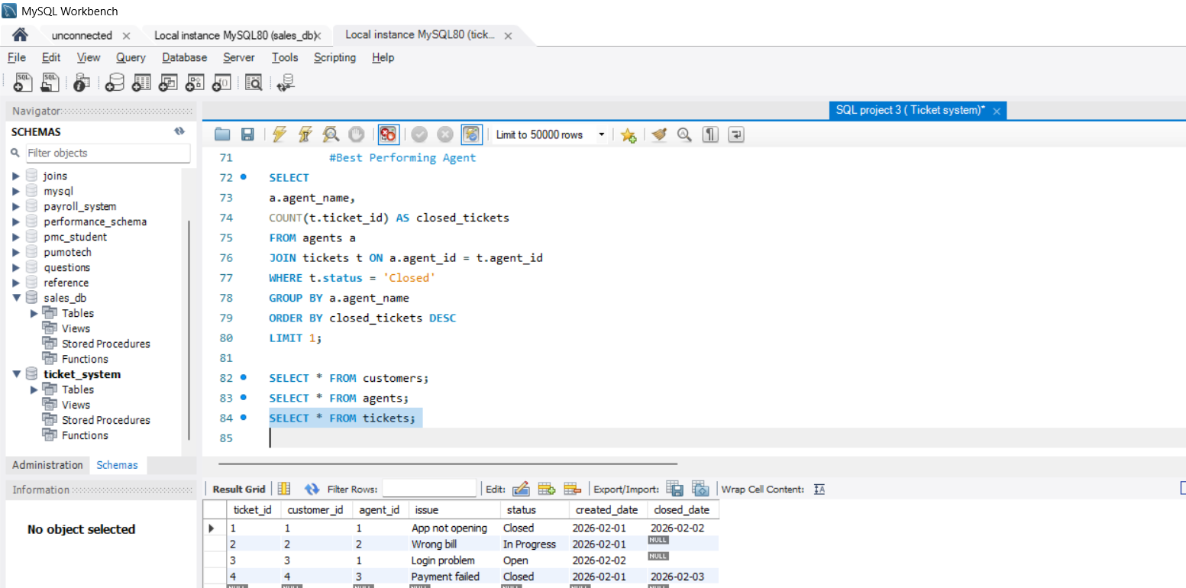
Ticket Information
“Each ticket contains issue, status, created date, and closed date.
Status can be Open, In Progress, or Closed.”

Slide 7
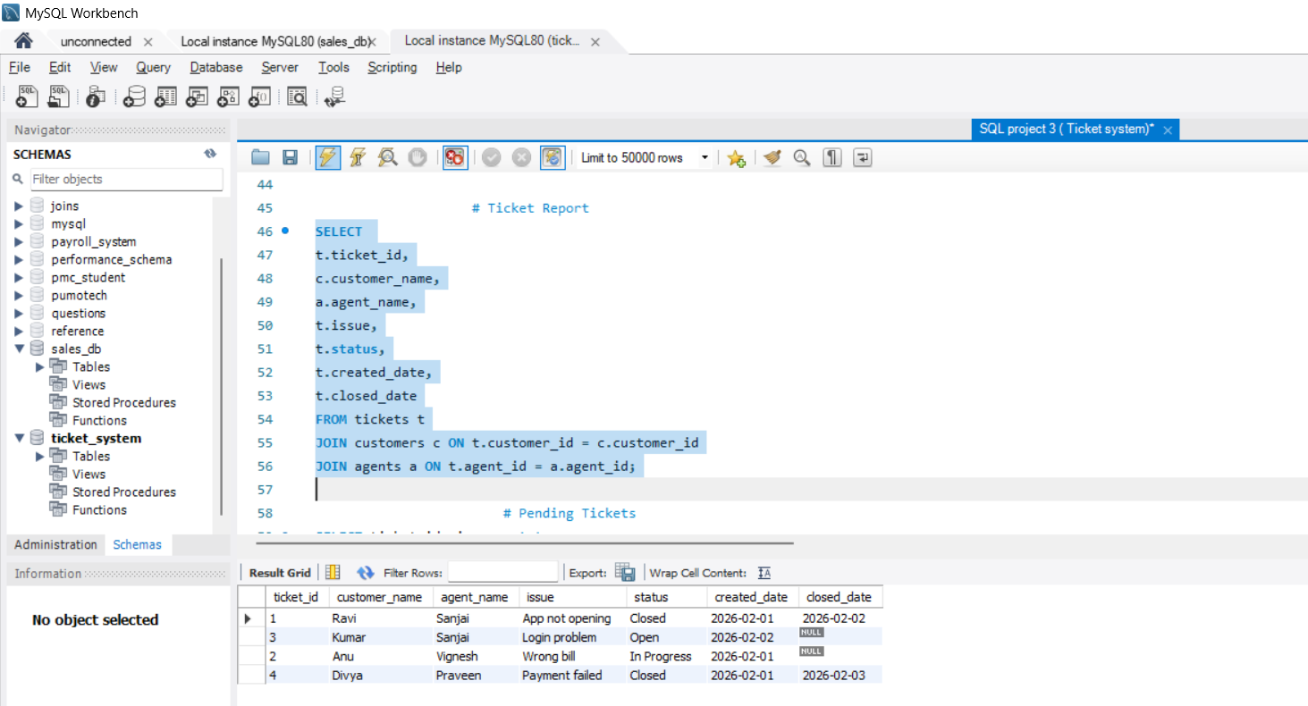
Ticket Report using JOIN
“This query joins tickets, customers, and agents to show a complete ticket report.”

Slide 8
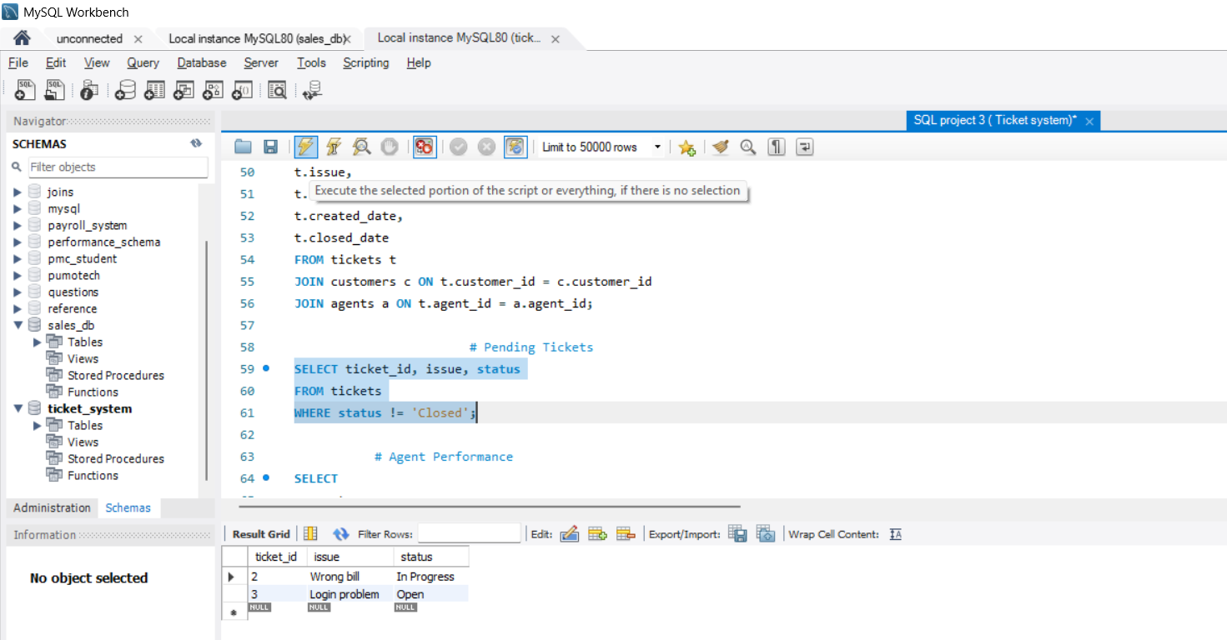
Pending Ticket List
“This query shows tickets which are not closed yet, so the company can track pending issues.”

Slide 9
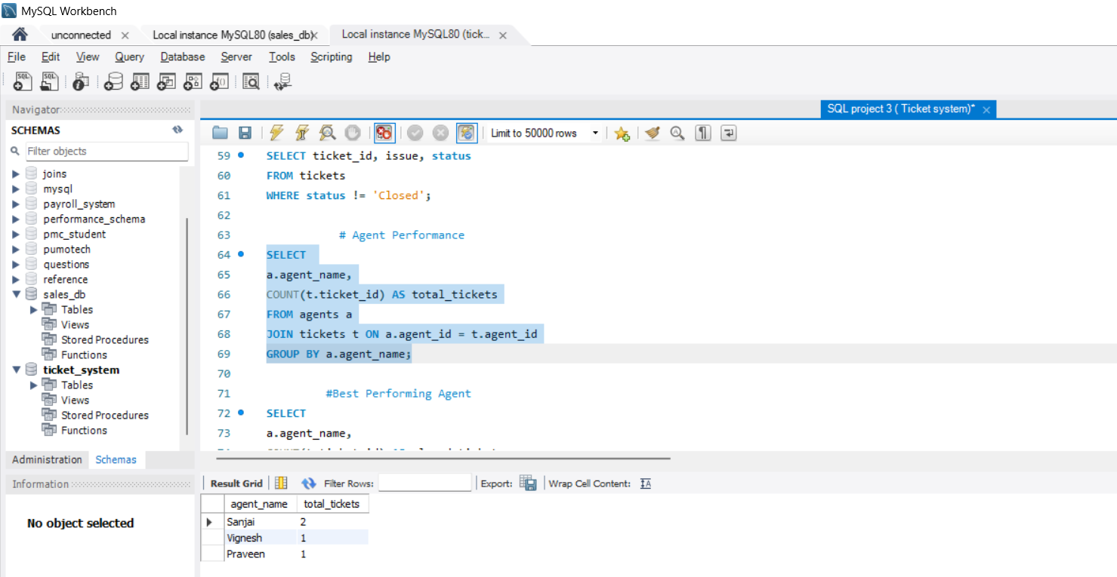
Agent Workload Report
“This query shows how many tickets each agent handled.”

Slide 10
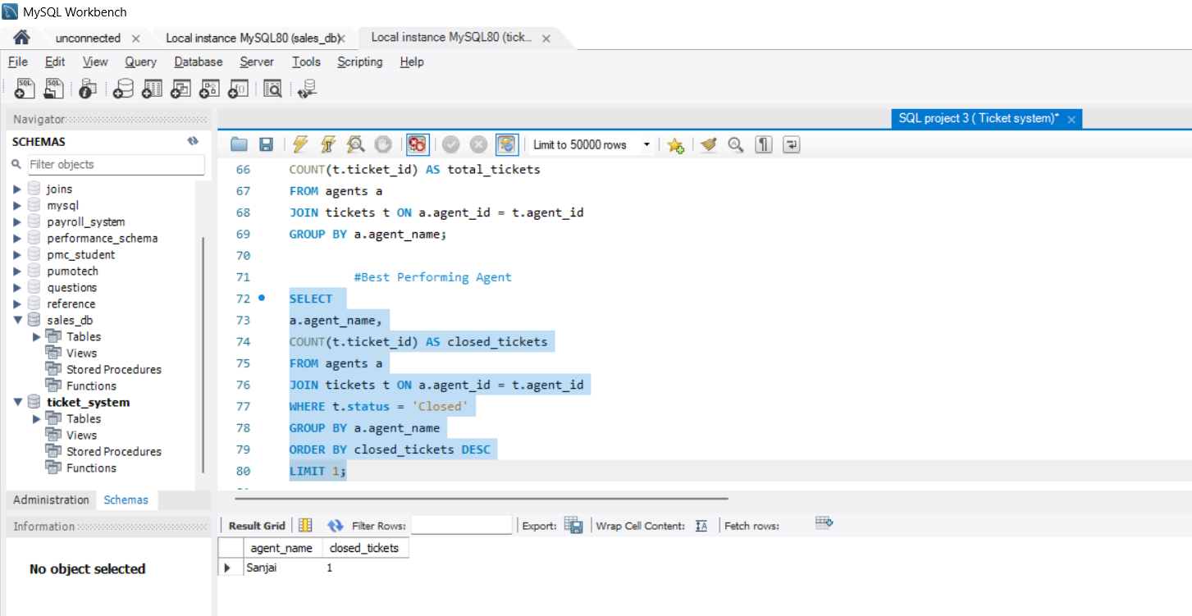
Top Performing Agent
“This query finds the agent who closed the highest number of tickets.”

